Slide 1
What to talk about
- What models are we using
- why? Niv et al., 2012; Lefebvre et al., 2017 for 2 learning rate (risk sensitive) temporal difference learning
- how well do they recover in predator and prey simulations (show plots)
- I’m running it with 83 simulations, which mimics the sample size I have with the hormone dataset
- how well are they identified with respect to each other? (show confusion matrix)
- How did we estimate the priors
- fixed effect across first decisions of many subjects (all datasets)
- How well do the models with the parameters recovered from real data predict actual behavior?
- plot expected offer against actual offers
- plot different learning outcomes of several subjects
- Start analyzing the behavioral, neural, and hormonal data with the parameters!

Slide 2
Why?
Individuals often act cooperatively even when the alternative is more personally profitable
Examples, people also fight each other all the damn time
Also interesting, in every day situations, we need to constantly interact with anonymous others. Predicting the behavior of these others is difficult, yet we do employ heuristics in order to accomplish this.
Perhaps one way that we acquire these heuristics is by learning an optimal distribution of behaviors that fits in certain situations.
Maybe our paradigm allows us to address this

Slide 3
The Predator Prey Game
Two-player, one-shot design
Rules
Each player starts with €10
If the prey invests as much or more than the predator, both keep their remaining endowment
If the predator invests more than the prey, predator adds preys remainder to his own remainder.
Prey survives
Predator kills
Predator
Endowment = €10
Investment = €3
Payout
10-3 = €7
Prey
Endowment = €10
Investment = €4
Payout
10-4 = €6
Predator
Endowment = €10
Investment = €5
Payout
10-5+(10-4) = €11
Prey
Endowment = €10
Investment = €4
Payout
€0

Slide 4
What do our subjects do?
Behavioral plots (simple barplots)
Predators invest lower than prey
Predators invest much less frequently than prey
In hormone dataset (maybe in both)
Previous reward impacts current trial, and this is more pronounced in prey than in predators

Slide 5
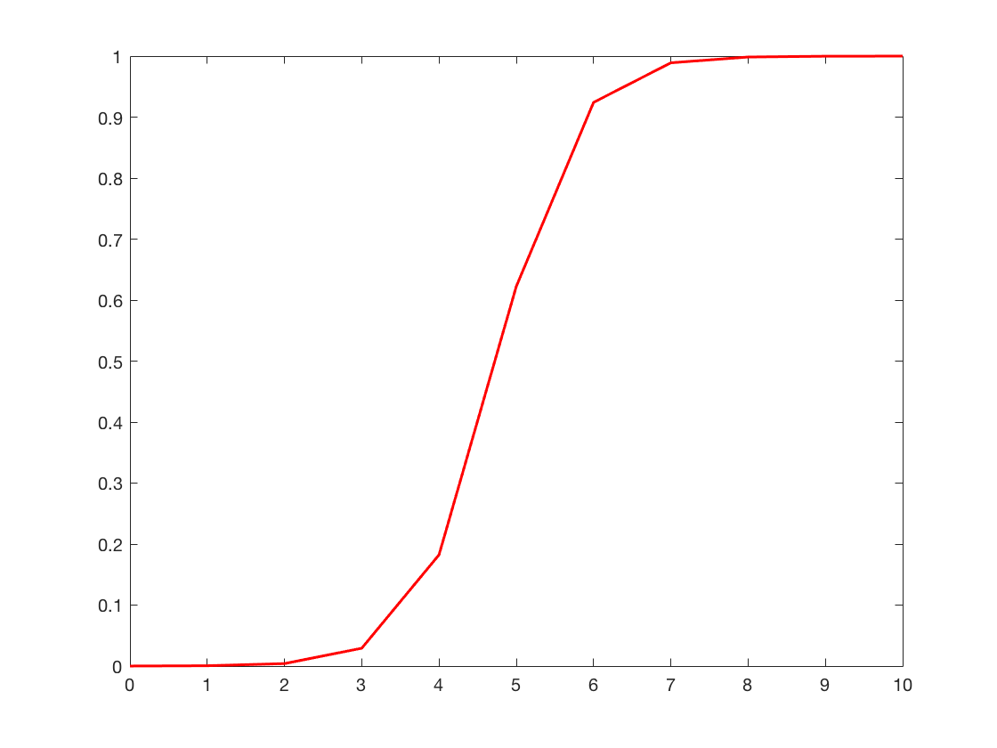
What could subjects be doing?
We submit that subjects are attempting to learn an optimal behavior from a noisy environment!
And how could they be doing this?
Not through simple Q-learning, that is too cumbersome and we believe psychologically unlikely
Specifically, we assume that a participant (P) learns a rival’s (R) acceptance logistic function 𝝋, which maps the investment amount into a victory or a defeat. This function is governed by two parameters, an intercept 𝝋_{R0} and a slope 𝝋_{R1}.
𝝋_{𝜷R1}
Probability of success
𝝋_{𝜷R0}
Investment

Slide 6
At each trial 𝒕, from his/her endowment 𝑬_{𝒕}, 𝑷 has to consider each possible offer 𝑨_{𝒕} and compute the expected payoff 𝑽_{𝒕}. This expected payoff depends on his/her estimate of how likely it is that 𝑨_{𝒕} will result in a victory: 𝑷_{𝑹,𝒕} (𝑫_{𝒕} = 𝟏|𝑨_{𝒕}), where 𝑫_{𝒕} represents whether A_{t} results in a victory (𝑫_{𝒕} = 𝟏) or a defeat (𝑫_{𝒕} = 0). This will occur if R’s investment I_{t} is lower than 𝑨_{𝒕} in the case of predators and lower than or equal to 𝑨_{𝒕} in the case of prey. For simplicity, this will be referred to as 𝑷_{𝑹,𝒕}(𝑨_{𝒕}). 𝑷’s expected payoff 𝑽_{𝒕} for the offer 𝑨_{𝒕} is:
𝑽_{𝒕}=[P_{𝑹,𝒕}(𝑨_{𝒕})×(𝑬_{𝒕}−𝑨_{𝒕})]+[(𝟏–𝑷_{𝑹,𝒕}(𝑨_{𝒕}))×𝟎] if P is prey. (1)
𝑽_{𝒕}=[(P_{𝑹,𝒕}(𝑨_{𝒕})×(E_{𝒕}− I_{𝒕}))+(𝑬_{𝒕}−𝑨_{𝒕})]+[(𝟏–𝑷_{𝑹,𝒕}(𝑨_{𝒕}))×(𝑬_{𝒕}−𝑨_{𝒕})] if P is predator (2)
With the two square brackets representing cases where 𝑨_{𝒕} is above (or equal to) or below I_{t}, respectively.
Critically, 𝑷 estimates 𝑷_{𝑹,𝒕}(𝑨_{𝒕}) by estimating 𝑹’s acceptance logistic function 𝝋. Specifically, P forms a representation ϑ of R’s acceptance function 𝝋 by forming estimates 𝜷_{𝑹𝟎} and 𝜷_{𝑹1} of 𝝋‘s intercept and slope, respectively.
𝑷_{𝑹,𝒕}(𝑨_{𝒕})=𝟏/(𝟏+𝒆𝒙𝒑(−(𝜷_{𝑹𝟎,𝒕}+𝜷_{𝑹𝟏,𝒕}×𝑨_{𝒕}))) (3)

Slide 7

𝑷 can choose 𝑨_{𝒕} according to a softmax function (multinomial), with a temperature parameter 𝜷
P(A_{t} = i) = $\frac{e^{β×V_{i}}}{\sum_{j=1}^{n}{β×V_{i}}}$ (3)
Learning can be done using a simple delta rule on ϑ’s two parameters 𝜷_{𝑹𝟎,𝒕} and 𝜷_{𝑹𝟏,𝒕}. This means that P first computes a choice prediction error 𝜹_{C𝒕}
𝜹_{C𝒕} = 𝑫_{𝒕}−𝑷_{𝑹,𝒕}(𝑨_{𝒕}) (4)

Slide 8
This choice prediction error can then be used to update the parameters for the next trial using a Rescorla-Wagner update function . For simplicity, we assume that 𝜷_{𝑹𝟏} will remain constant, while 𝜷_{𝑹𝟎} will be updated on each trial. We propose four different iterations of an update procedure that P can conceivably utilize in order to learn 𝝋.
Case 1: P updates his/her 𝛃_{R0} at time t using the choice prediction error δ_{Ct} and a single learning rate α. Specifically, if δ_{Ct} is positive, P increases 𝛃_{R0} (meaning P lowers the investment value necessary for victory), and if δ_{Ct} is negative P decreases 𝛃_{R0} (meaning P raises the investment value necessary for victory – recall that increasing the intercept shifts the entire logit function to the right and hence lowers the expected probability of success for each investment):
𝛃_{R0,t+1}=𝛃_{R0,t}+α× δ_{Ct} (5)

Slide 9
Case 2: P updates his/her 𝛃_{R0} at time t using the choice prediction error δ_{Ct} and two learning rates: α⁺ for positive prediction errors, and α⁻ for a negative prediction errors:
𝛽_{R0,t+1}=𝛽_{R0,t}+α⁺× δ_{Ct} if δ_{Ct} > 0 (6)
𝛽_{R0,t+1}=𝛽_{R0,t}+α⁻× δ_{Ct} if δ_{Ct} < 0
Case 3: P updates his/her 𝛃_{R0} at time t using the reward prediction error δ_{R} and a single learning rate α. The calculation of δ_{R} is accomplished by subtracting the actual reward from the expected reward and is equivalent to the following expressions (see supplementary slides for full derivations of these equations):
δ_{Rt} = δ_{Ct} × (𝑬_{𝒕}−𝑨_{𝒕}) if subject is prey (7)
δ_{Rt} = δ_{Ct} × (I_{t} −𝑨_{𝒕}) if subject is predator (8)

Slide 10
δ_{Rt} is then used by P to update ϑ in the same way δ_{Ct} was used in cases 1 and 2:
𝛃_{R0,t+1}=𝛃_{R0,t}+α× δ_{Rt} (9)
Case 4: P updates his/her 𝛃_{R0} at time t using the reward prediction error δ_{Rt} and two learning rates: α⁺ for positive prediction errors, and α⁻ for a negative prediction errors:
𝛽_{R0,t+1}=𝛽_{R0,t}+α⁺× δ_{Rt} if δ_{Ct} > 0 (10)
𝛽_{R0,t+1}=𝛽_{R0,t}+α⁻× δ_{Rt} if δ_{Ct} < 0

Slide 11
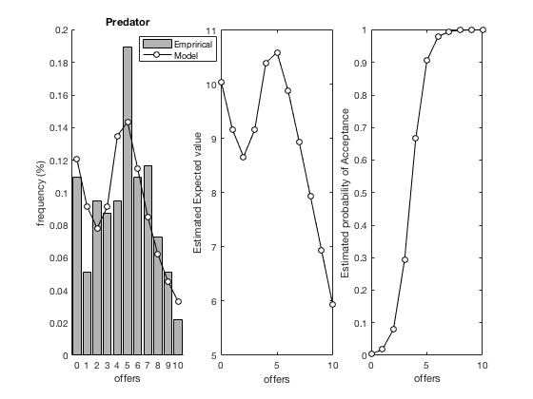
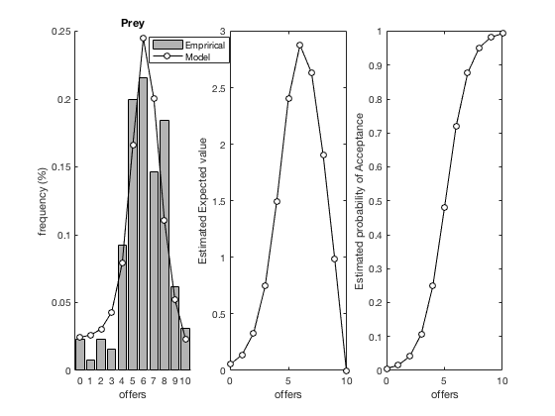
Empirical Priors
Importantly, to avoid fitting additional free parameters, the model requires initial estimates of 𝜷_{𝑹𝟎} and 𝜷_{𝑹𝟏}.
We estimated these as fixed effects from the first investments made by subjects playing the game for the first time. We used data from several datasets, amounting to a total of 267 subjects, 130 player as prey and 137 playing as predator*. Importantly, we constrained the parameters using a Laplace procedure, allowing us to stay away from the bounds of the parameter space.
* Prey: 12 (old_hor) + 81 (hor) + 25 (ital) + 12 (OT)
Predator: 12 (old_hor) + 85 (hor) + 25 (ital) + 15 (OT) the parameters and accompanying plots were produced by PPG/empirical_priors_mg_predprey_2017_10_03.m

Slide 12
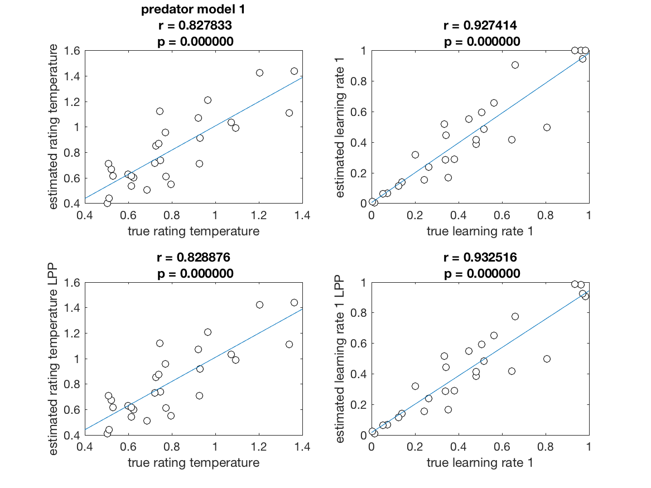
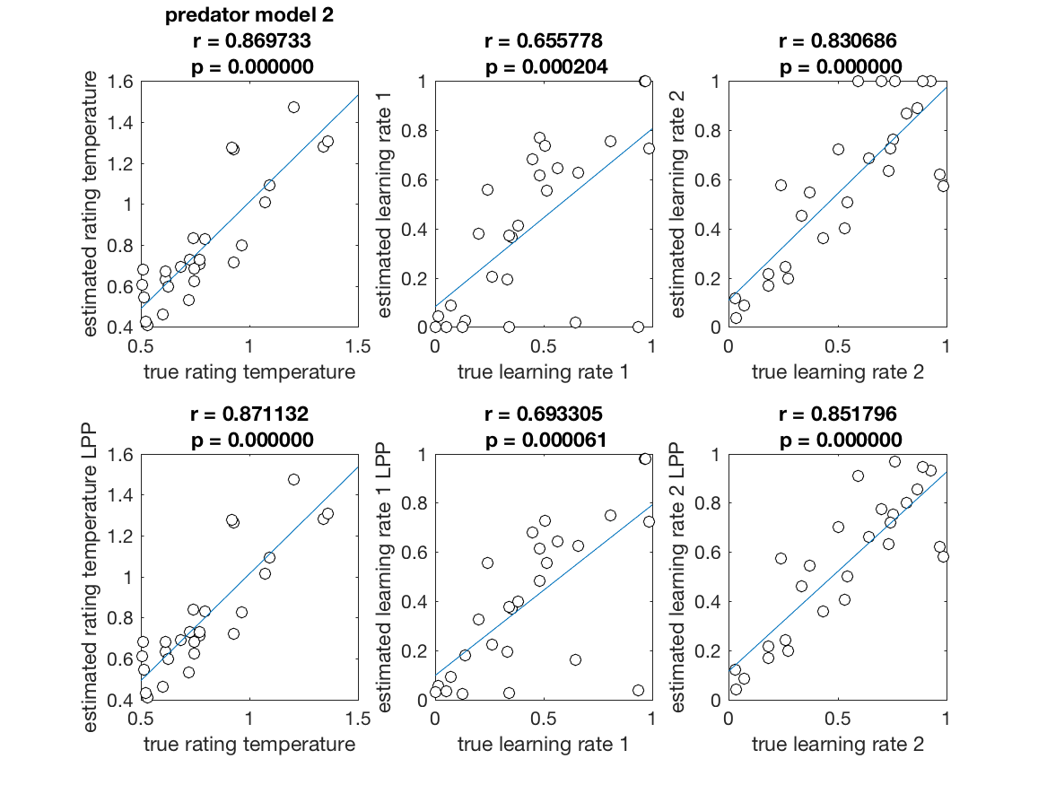
Simulations: Experiment 4 Recovery for Predators
27 simulated subjects in predator role with 20 trials over 3 sessions (so reset to priors 3 times – i.e. mimicking fMRI dataset). Simulations were all playing against acceptance function estimated from actual distribution against which real subjects were playing. For each simulation, model parameters were randomly selected. Models were then fit to data generated from those simulations. These plots show correlations between the parameters recovered from the fitting process and the true parameters used to generate the data
from PPG/test_recovery_models_MG.m
Top row represents unconstrained parameter estimation, bottom row represents Laplace constrained. Columns 1 and 2 represent parameters for case 1, columns 3-5 represent parameters from case 2.

Slide 13
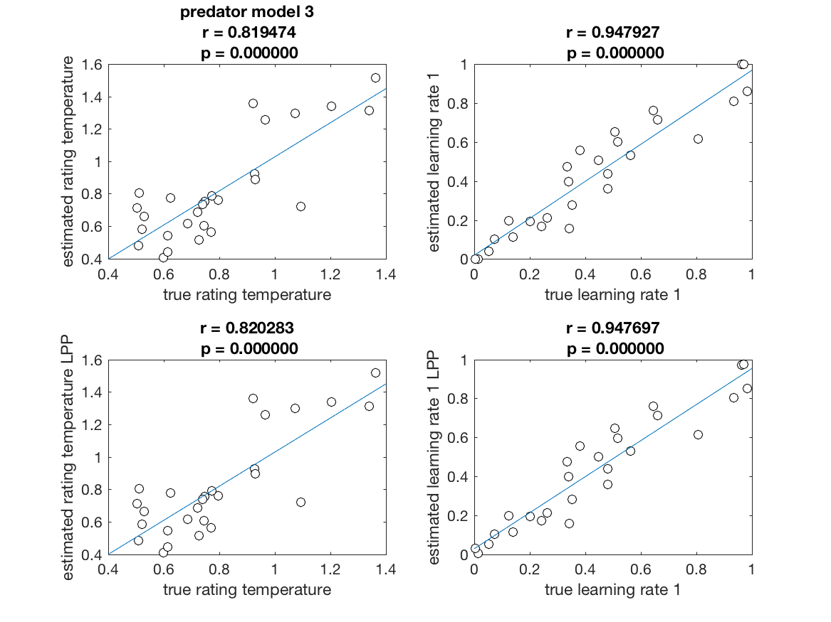
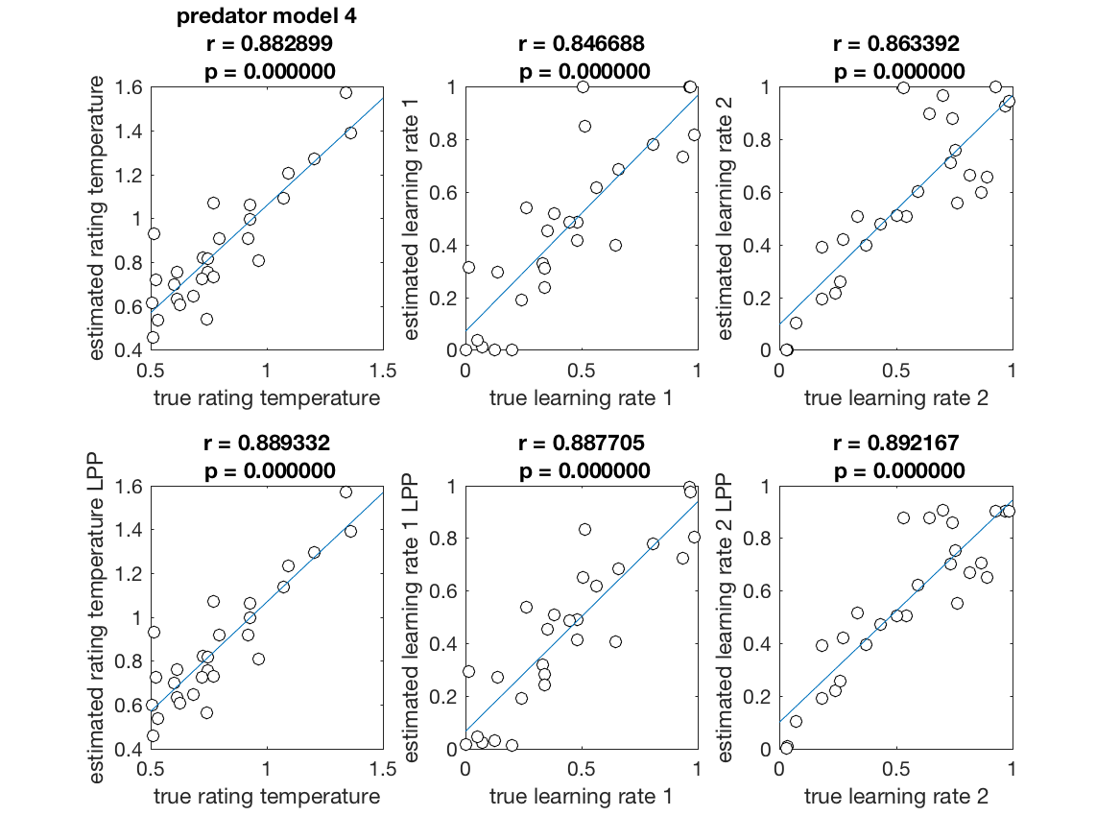
Simulations: Experiment 4 Recovery for Predators
27 simulated subjects in predator role with 20 trials over 3 sessions (so reset to priors 3 times – i.e. mimicking fMRI dataset). Models were then fit to data generated from those simulations. These plots show correlations between the parameters recovered from the fitting process and the true parameters used to generate the data
Top row represents unconstrained parameter estimation, bottom row represents Laplace constrained. Columns 1 and 2 represent parameters for case 1, columns 3-5 represent parameters from case 2.

Slide 14
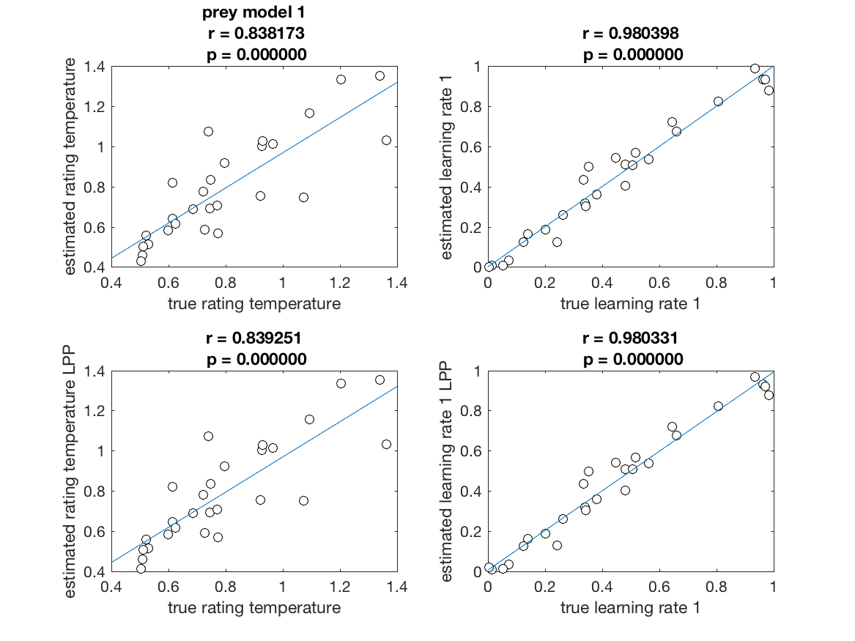
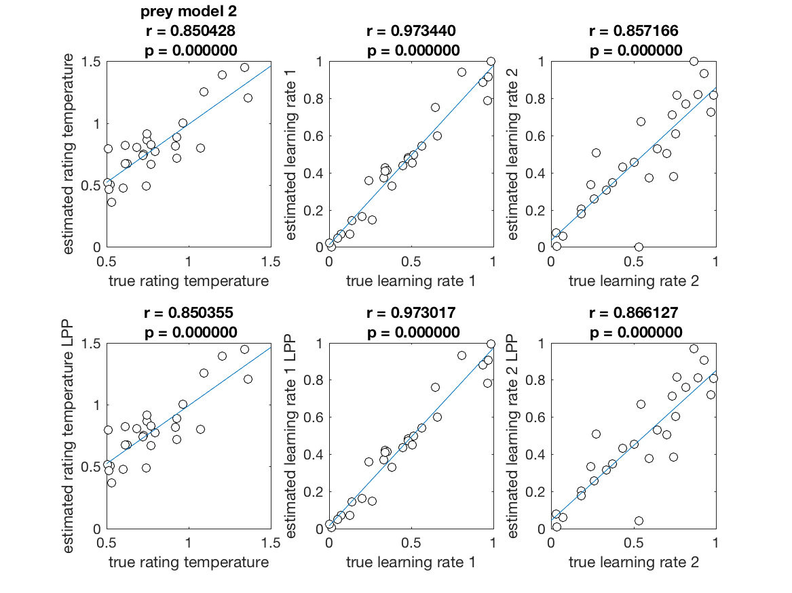
Simulations: Experiment 4 Recovery for Prey
27 simulated subjects in prey role with 20 trials over 3 sessions (so reset to priors 3 times – i.e. mimicking fMRI dataset). For each simulation, model parameters were randomly selected. Models were then fit to data generated from those simulations. These plots show correlations between the parameters recovered from the fitting process and the true parameters used to generate the data
Top row represents unconstrained parameter estimation, bottom row represents Laplace constrained. Columns 1 and 2 represent parameters for case 1, columns 3-5 represent parameters from case 2.

Slide 15
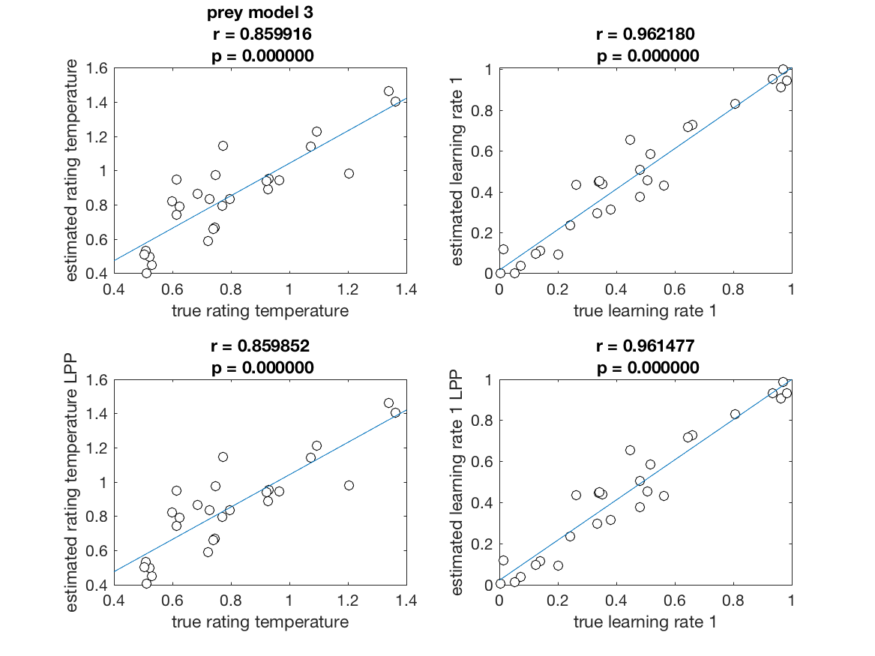
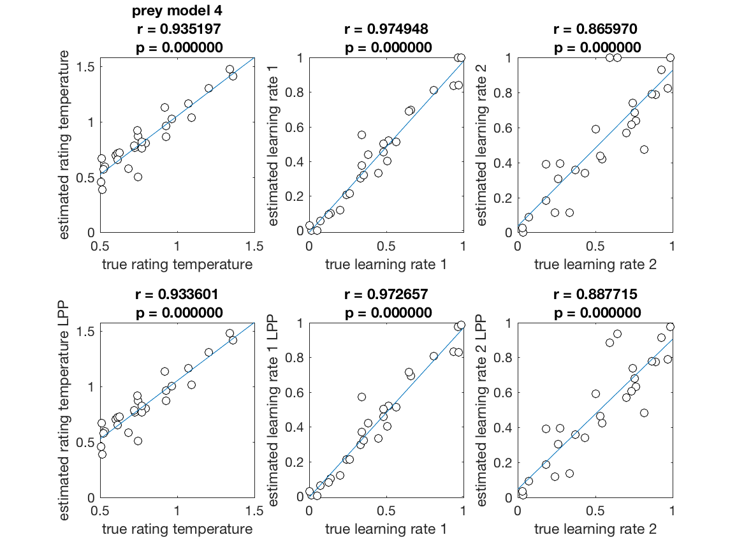
Simulations: Experiment 4 Recovery for Prey
27 simulated subjects in prey role with 20 trials over 3 sessions (so reset to priors 3 times – i.e. mimicking fMRI dataset). Models were then fit to data generated from those simulations. These plots show correlations between the parameters recovered from the fitting process and the true parameters used to generate the data
Top row represents unconstrained parameter estimation, bottom row represents Laplace constrained estimation. Columns 1 and 2 represent parameters for case 3, columns 3-5 represent parameters from case 4.

Slide 16
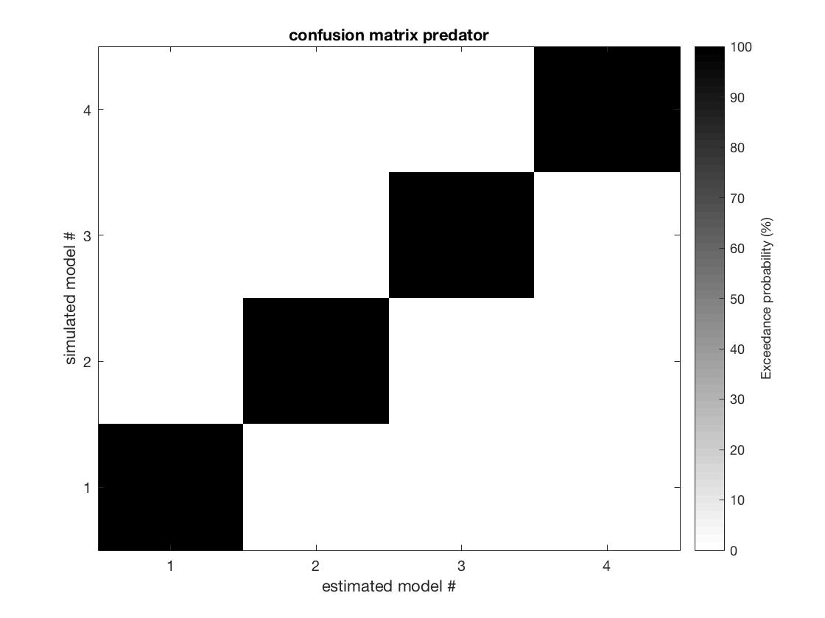

Simulations: Experiment 4 Model Identifiability: Confusion Matrices
Confusion matrices. Each row represents the model that was used to simulate the data (cases 1-4), and each column represents the model that was used to fit the data. Darkness of cell indicates evidence in favor of model, gleaned from Variational Bayesian Analysis implemented in the VBA toolbox for MATLAB (Daunizeau et al., 2014). The black diagonal and white off-diagonal indicate that models are sufficiently identifiable with respect to one-another

Slide 17
Simulations summary
As can be seen from figures 1-

Slide 18
Experiments
Experiment 1: within subject design; 27 subjects played both roles in blocks of 20 trials for 1 session, total of 120 trials in fMRI machine.
Experiment 2: within subject design; 24 subjects played both roles in blocks of 60 over two sessions, total of 120 trials in behavior lab (hormone study)
Experiment 3: between subject design; 50 subjects played in one role for one block of 60 trials, total of 60 trials (hormone study)
Experiment 4: between subject design; 166 subjects played in one role for one block of 60 trials, total of 60 trials per subject (hormone study)

Slide 19
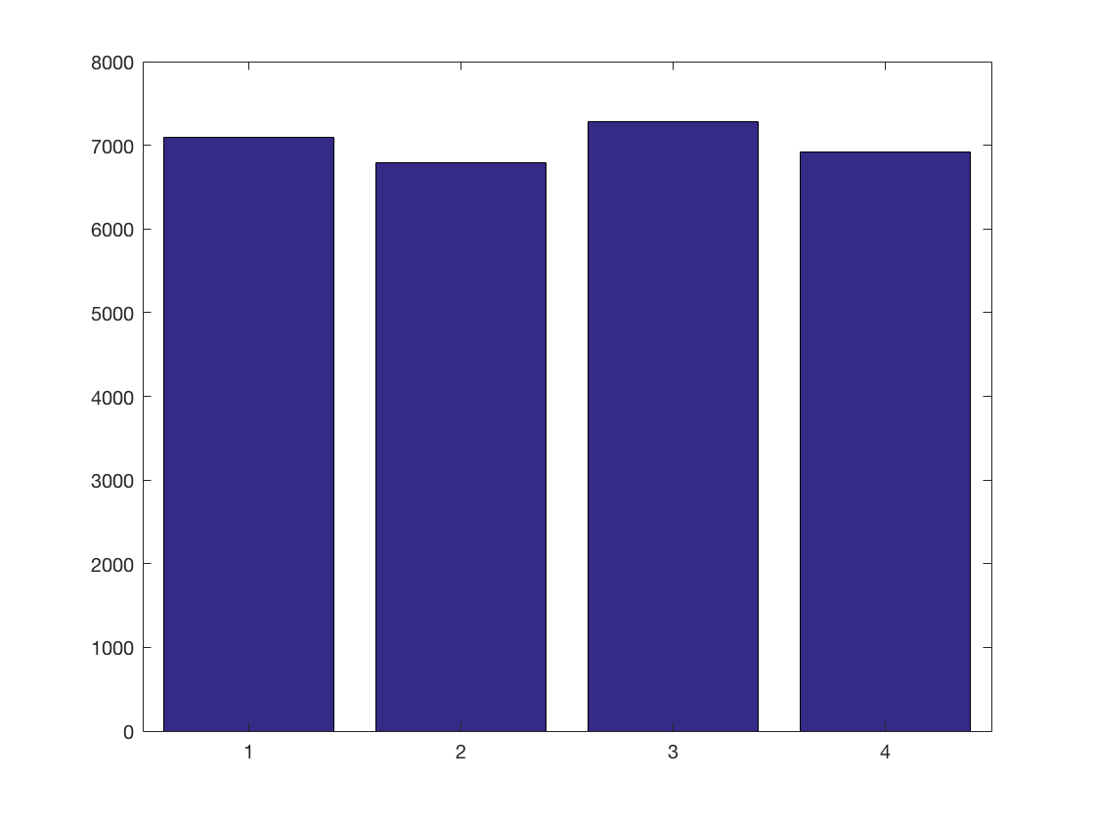
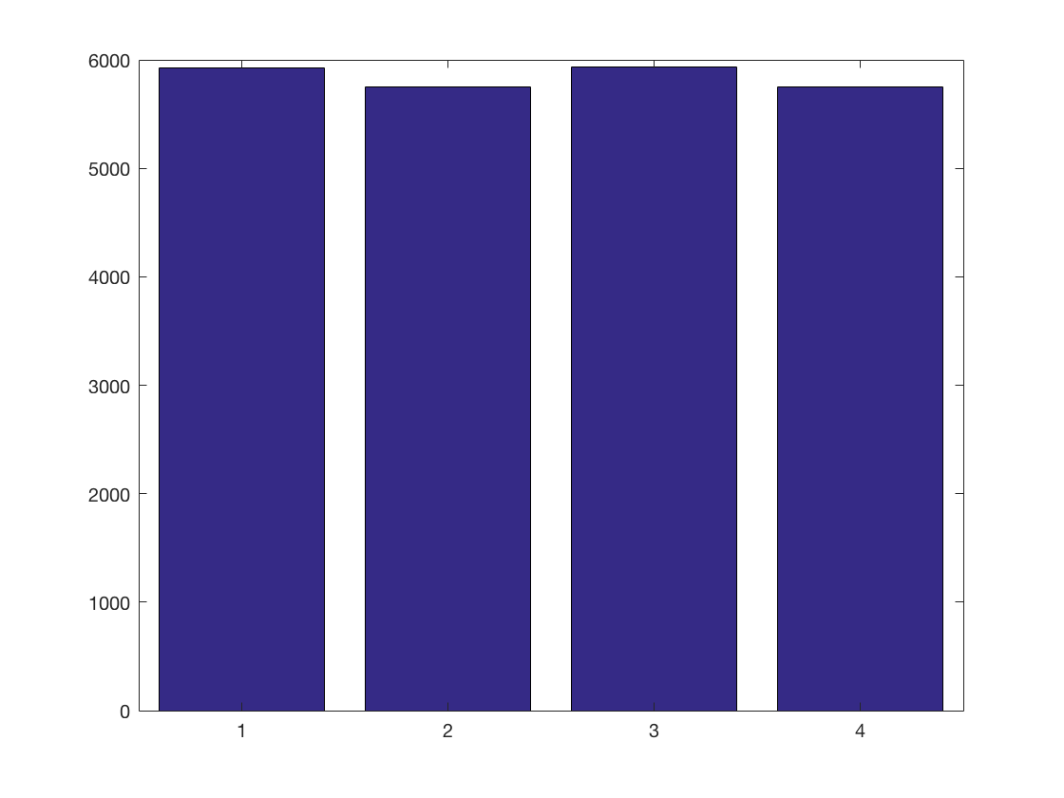
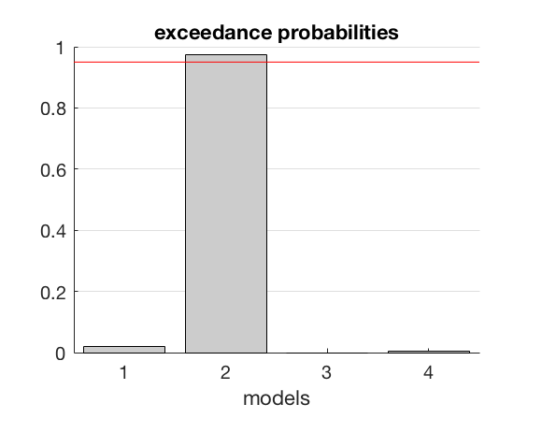
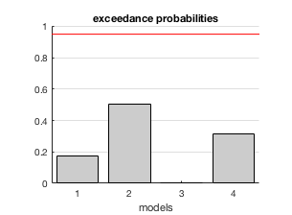
Model fits to real data
The left plot is model fits to predator data, and the right plot are model fits to prey data. The top row is the result of a fixed effect analysis in which BIC’s were summed across subjects. Lower BIC indicates better fit to the data. As can be seen, (more clearly or predators than for prey), model 2 wins in both cases (albeit by a very slim margin).
The bottom row indicates the evidence in favor of each model as result of random effect analysis across subjects using Variational Bayesian Analysis implemented in the VBA toolbox (Daunizeau et al., 2014). As can be seen, for predators model 2 is the clear winner, while the results of prey are more ambiguous.
Note to self – make these plots in ggplot2 if we decide to stick with this analysis, need to have values at the top
Predator
Prey

Slide 20
Findings
I then used as parametric regressors: expected value, expected risk (with a 5 second delay as recommended by Preuschoff et al., 2008), prediction error, and risk prediction error. What I found is:
Expected Reward/ prediction errors (expected reward in selection and prediction errors in feedback)
Predator feedback
Nothing
Prey feedback
VMPFC: p=0.0706
Predator selection
Negative activation everywhere (not sure why or how this happened)
Prey selection
Nothing

Slide 21
Findings
Here is delayed risk and risk prediction errors
Expected risk/ risk prediction errors (expected risk 5 seconds after selection, risk prediction error during feedback)
Predator feedback
Amygdala (negative): p=0.033
Ventral Striatum (negative): p=0.028
Prey feedback
Nothing
Predator selection
Amygdala (positive): p=0.0608
Anterior Insula (positive): p=0.0214
DLPFC (positive): p=0.0254
VMPFC (positive): p=0.0254
Whole brain (positive): lots of places, p,0.025: IFG, thalamus, TPJ,

Slide 22
Findings
Here is delayed risk and risk prediction errors
Expected risk/ risk prediction errors (expected risk 5 seconds after selection, risk prediction error during feedback)
Prey selection
Amygdala (positive): p=0.069
DLPFC (positive): p=0.0302

Slide 23
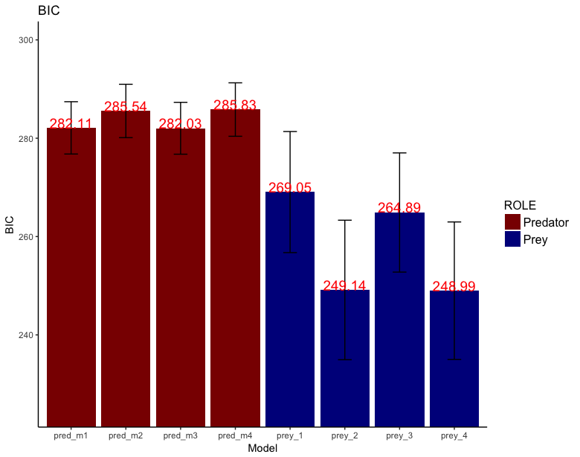
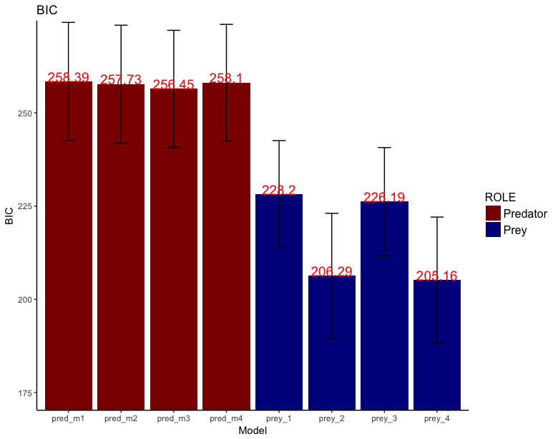
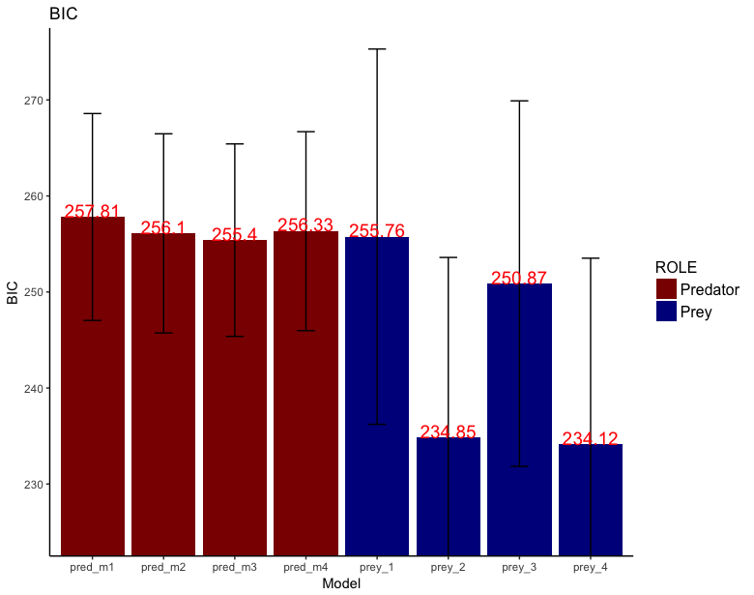
Model fits to real data
I fit each model to the behavioral data of three different datasets and assessed the goodness of fit by comparing the BIC of each model, across subjects, separately for predator and for prey. As can be seen from figures #, in each dataset model 3 yields the lowest BIC for predators (red bars), indicating a better fit to the data, while model 4 yields the lowest BIC for prey (blue bars). This means that predator behavior is better explained by a learning model with 1 learning rate, and prey behavior is better explained by a learning model with 2 learning rates. Furthermore, while there is no significant difference between models 1 and 3 for predators nor models 2 and 4 for prey, based on the simulated model identifiability test visualized in the confusion matrices in figure #, in which these models are likewise similar in terms of BIC, we should not expect a significant difference between these models even if subjects were using them perfectly to generate their behavior.
***
***
Exp. 4
Exp. 3
Exp. 2
***
***
*
N = 166, b/w sub design
N = 50, b/w sub design
N = 24, w/in sub design
Asterisks represent significant results of paired t-tests, ”*” represents p<0.05, “**” represents p<0.01, and “***” represents p<0.0001

Slide 24
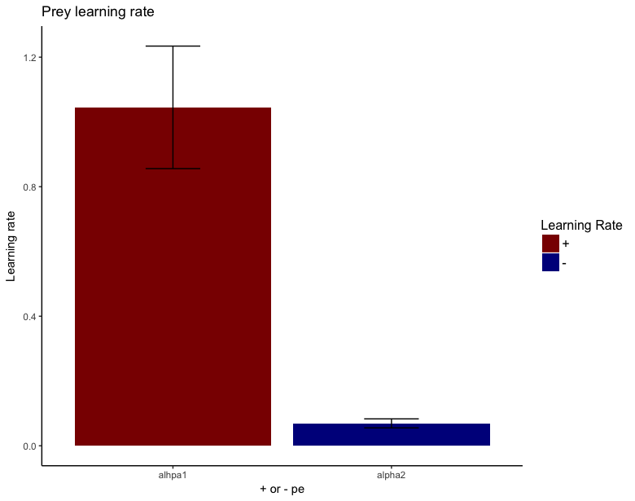
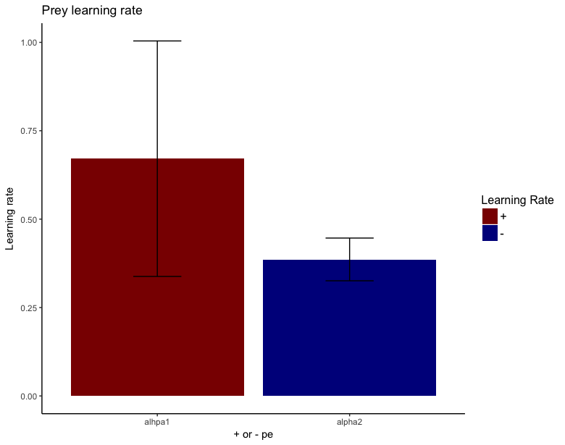
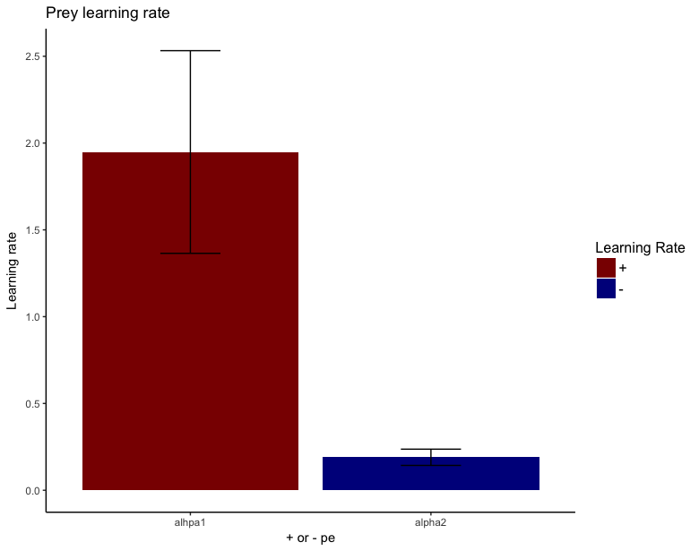
Model fits to real data
When examining the model parameters of the most parsimonious models, we see that prey in fact exhibit a large difference in terms of learning rate, but only for two out of the three datasets (results of paired t-tests). This means that prey their behavior much stronger to a positive prediction error than to a negative prediction error, and in effect indicates that they behave in risk-seeking rather than risk-avoiding manner.
Exp. 4
Exp. 3
Exp. 2
t(1, 80)=5.26, p<0.0001
t(1, 24)=0.81, p=0.43
t(1, 23)=3.22, p=0.0038

Slide 25
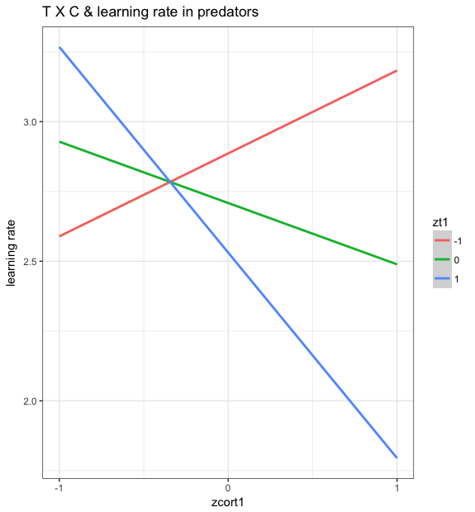
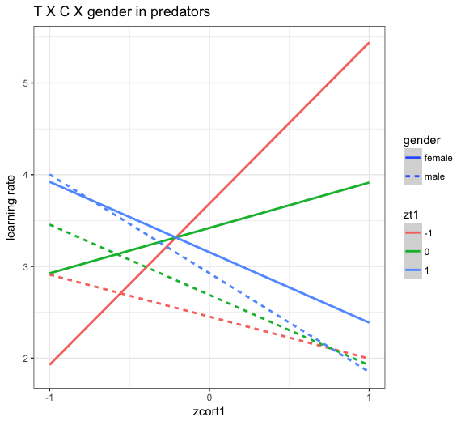
Model fits to real data experiment 4
When examining the parameters of the most parsimonious model in predators (model 3, reward learning with a single learning rate), we used multiple linear regression with cortisol, testosterone, gender, and the interactions between all three as independent variables, and learning rate as the dependent variable, with BMI included as a covariate (largest VIF = 5.22). We have a significant interaction between testosterone and cortisol, and a marginally significant 3-way interaction between testosterone, cortisol, and gender.
Learning rate as DV and T, C, TXC, and BMI as IV’s
TXC interaction: t=-2.46 p=0.016
TXCXgender interaction: t=1.87, p=0.066
Cxgender interaction: t=-2.192, p=0.031
TXC interaction: t=-2.80, p=0.0065
Whole model: F(8, 76)=2.28, p=0.031

Slide 26
Model fits to real data
Because in our within subject design, subjects played over two sessions, starting either as predator or as prey, we feel that looking for a between subject effect is confounded.
For example, a multiple regression with testosterone, cortisol, and distribution included as independent variables and learning rate as the response variable, with BMI and session as covariates, the variance inflation factor reaches unacceptable levels, VIF=15.08 for TXCXdistribution, and a VIF=15.57 for TXC. With distribution included only as an additive term, VIF’s all <2. However, this analysis reveals a marginally significant effect of session, t=-2.01, p=0.061.
Nevertheless, I’ve included the plot here with testosterone, cortisol, and their interaction, as well as distribution (as an additive term) as independent variables, and BMI and session as covariates (both marginally significant, session: t=-2.01, p=0.061, BMI: t=1.77, p=0.094).
For the between subject dataset with 50 participants, the VIF for distribution is also high: VIF=9.90 for TXCXdistribution, and a VIF=9.48 for TXC. Nevertheless, I have included it here with the same model as that stipulated for the within subject design mentioned in the previous comment.

Slide 27
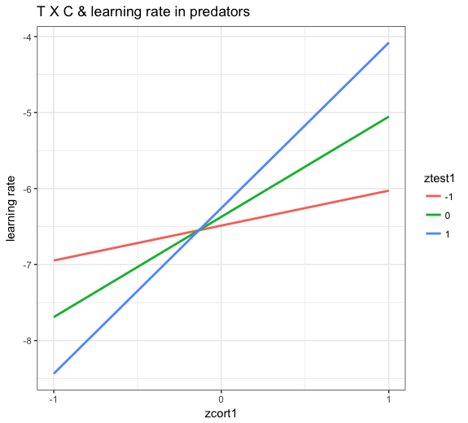
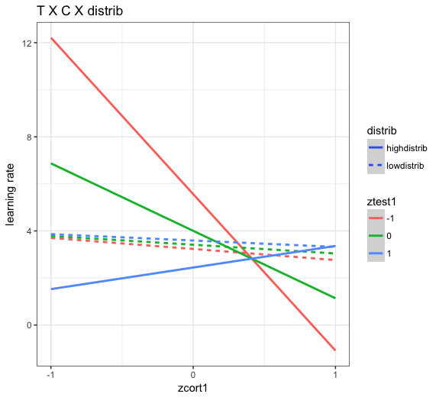
Model fits to real data
t=0.80, p=0.44
TXCXdistrib: t=-2.47 p=0.025
TXC: t=3.05, p=0.0076
When distribution is removed as an interaction term in the ital dataset (left plot), nothing is significant

Slide 28
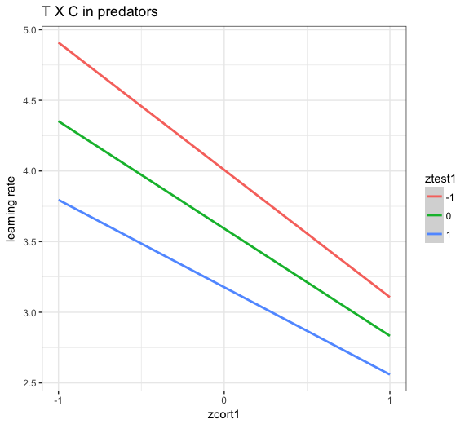
Model fits to real data
t=0.80, p=0.44
(cort: t=2.05, p=0.056)
T, C, and TXC all p’s>0.19
(cort: t=-1.3, p=0.19)
When distribution is removed as an interaction term in the ital dataset (right plot), nothing is significant

Slide 29
Model fits to real data
Hor dataset
Ital dataset
TXCXgender interaction: t=1.87, p=0.066
Cxgender interaction: t=-2.192, p=0.031
TXCXdistrib: t=-2.47 p=0.025
TXC: t=3.05, p=0.0076
Whole model: F(8, 76)=2.28, p=0.031
When distribution is removed as an interaction term in the ital dataset (right plot), nothing is significant

Slide 30
Model fits to real data
What appears to be the case here, is that females do indeed exhibit a significant relationship between hormones and learning rate, while men do not. Predominantly in women, having an imbalance of cortisol and testosterone, in either direction (higher cortisol relative to testosterone or high testosterone relative to cortisol) leads to higher learning rates, while having similar levels of each leads to low learning rates.
Men do exhibit other relations to hormones, such as investments (show plots), but investments are in fact an omnibus measure of a second by second constantly fluctuating state, for which hormones are not the best measure. What is a better measure of this is neural activity. So, this leads quite obviously to the question – what is happening in the male brain in relation to the latent parameters of our model?
fMRI study: 27 participants, both play 60 trials as predator and 60 trials as prey in blocks of 20 trials within 1 session. This is in stark contrast to the previously mentioned studies. Two of the previous three studies were between subject designs wherein subjects only played one role. In the within subject study previously mentioned, subjects played one session in one role, one block of 60 trials, and then came back a minimum of 1 week later to play in the opposite role.
This fMRI study is the only one wherein subjects switched from role to role within one session.

Slide 31
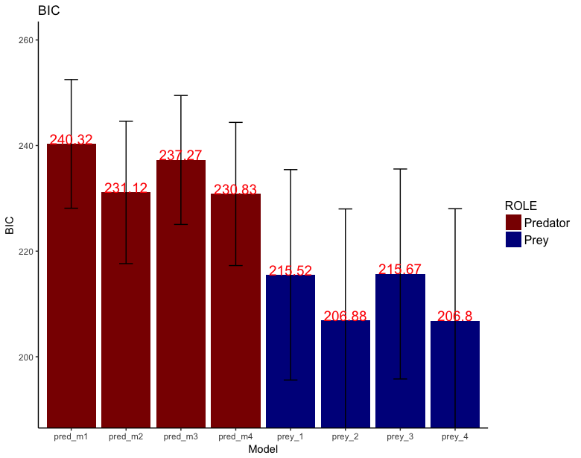
Model fits to real data
Similar to the previous studies, model 4 fit prey behavior best. However, in contrast to the previous studies, model 4 also fit predator behavior. This suggests that when subjects alternate between roles in close succession, their learning mechanisms appear to shift from predatory to prey-like. ANOVA’s on the BIC’s were not significant, prey p=0.11, predator p=0.064. Likewise, t-tests were all not significant

Slide 32
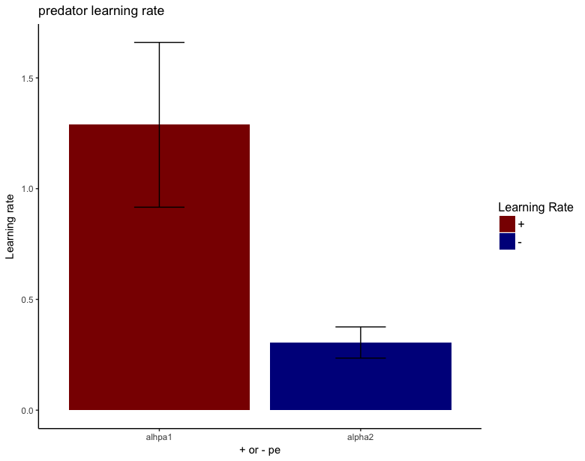
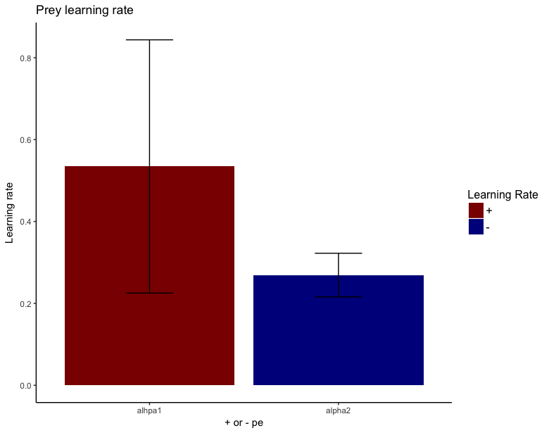
Model fits to real data
Interestingly, while the difference in learning rates for prey is in the same direction as the previous experiments, it does not reach significance for prey, t(26)=0.92, p=0.37, but does for predators, t(26)=2.74, p=0.011.
t(26)=2.74, p=0.011
t(26)=0.92, p=0.37

Slide 33
Model fits to real data
I fit the model to actual data, each model, and assessed the goodness of fit by comparing the BIC of each model, across subjects, separately for predator and for prey. I found that predator’s have their data best explained by model 3, and prey by model 4. This suggests that prey employ two separate learning rates, and predators only one. This further suggests that prey are behaving much more risk averse, since their model is essentially the same as the risk-sensitive model used by Niv et al. 2012.
Furthermore, I found a significant CXT interaction with learning rate in both predators and prey, although the effect was just barely below the significant threshold in prey. Furthermore, this relationship in prey was only present in one learning rate, that learning from negative prediction errors. Finally, when using BIC as a DV, I find a significant cortXgender effect in predators.
For prey, alpha1 is higher than alpha2, which means learning from positive predictions errors is stronger than learning from negative, which means our prey are actually risk seeking.
For the old_hor and ital datasets, the same models best explain the data for predator and prey, but there is really no other relationship to model parameters. It seems the females are entirely driving the effect in the hor dataset. Females also appear to have a nonsignificant higher learning rate than males.
However, when I include distribution as an interaction term in the ital dataset, I get a singificantl 3-way interaction with testosterone, cortisol, and distribution, as well as a significant tXC interaction going in the opposite direction as with the hor dataset, which I need to explore further.

Slide 34
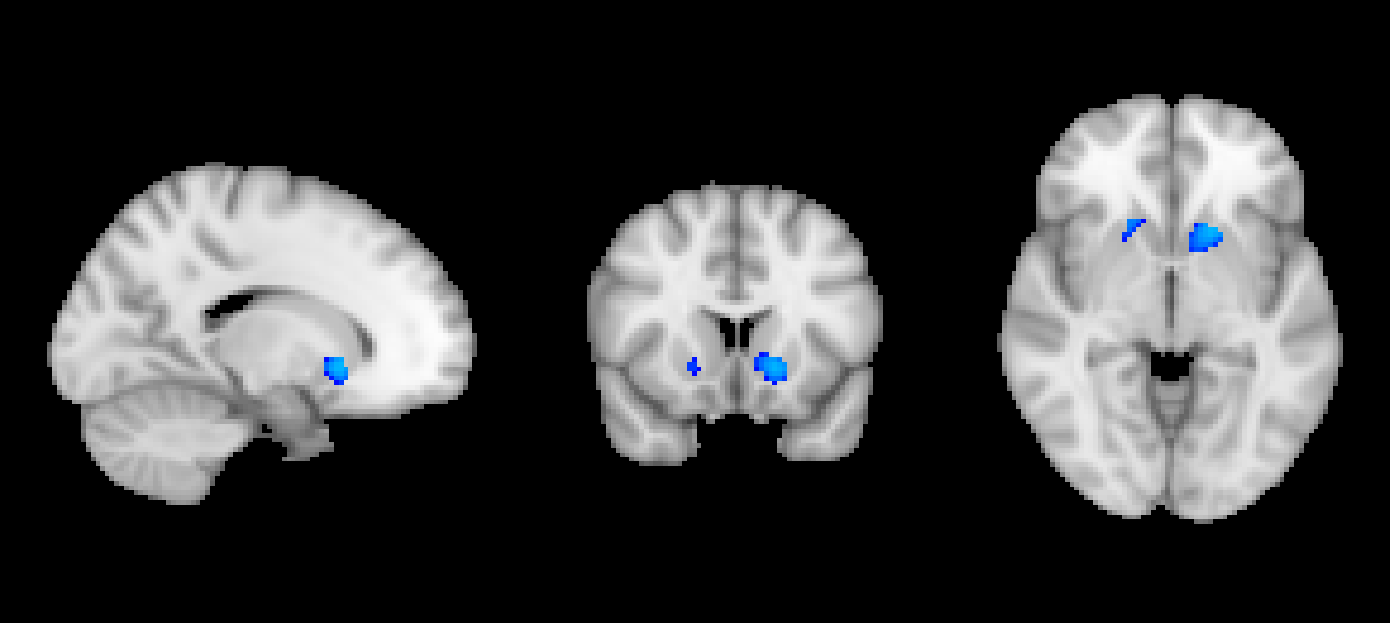
Model 3 Predator select
Negative VS activation

Slide 35
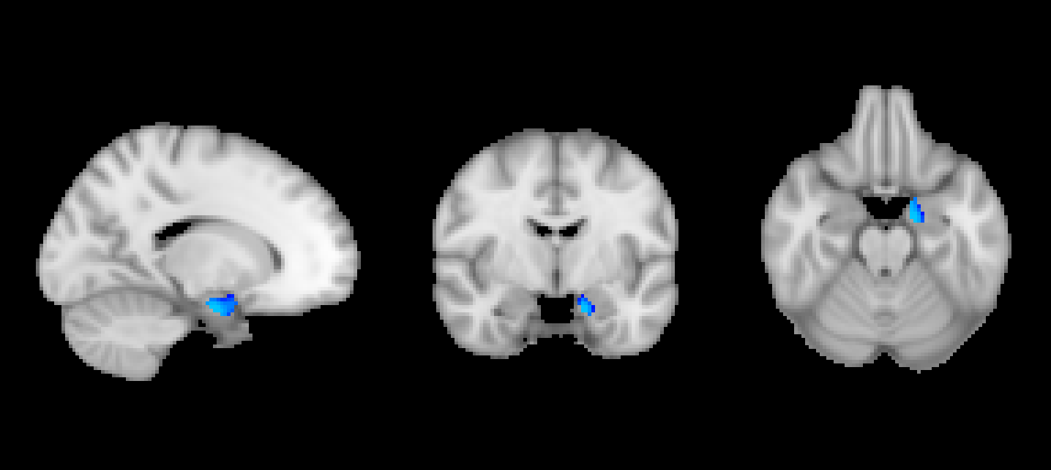
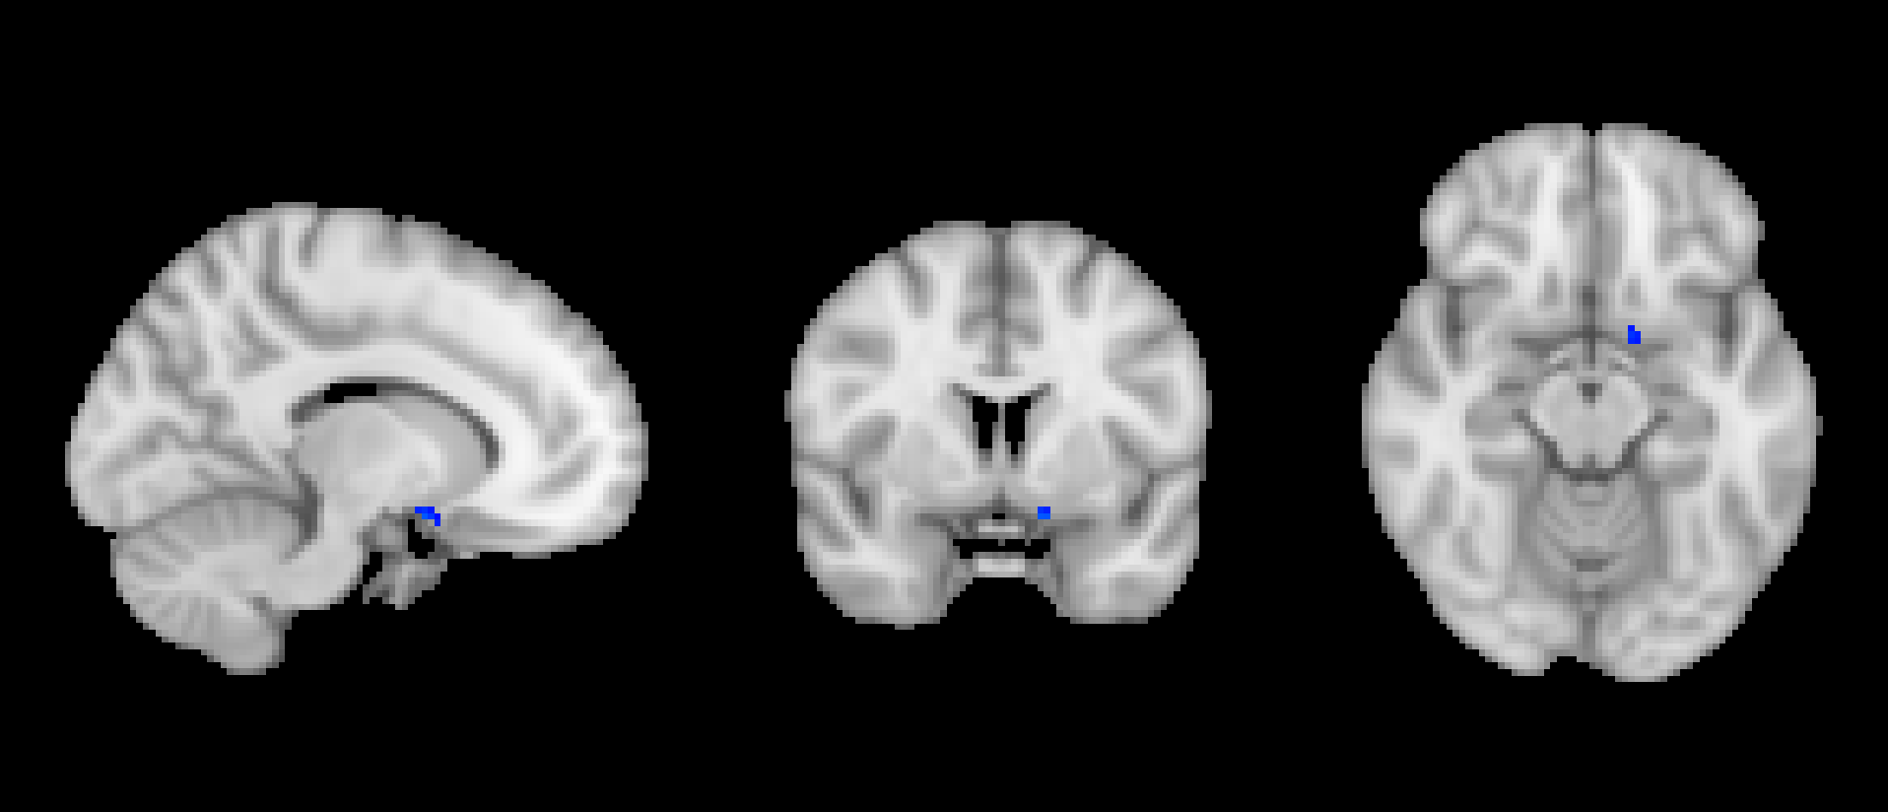
Model 3 prey feedback
Negative amygdala, negative VS

Slide 36
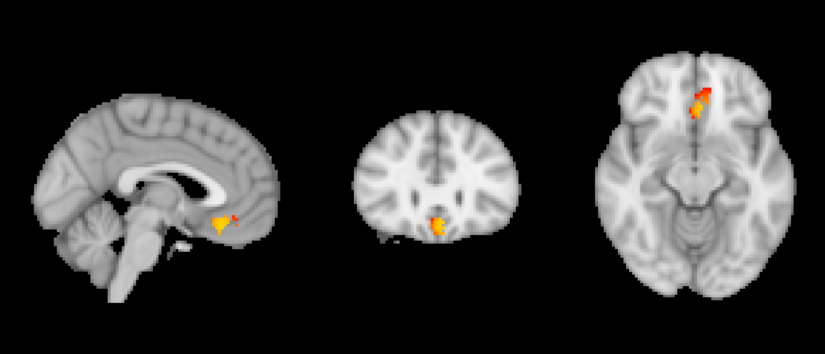
Model 3 prey selection
Positive VMPFC

Slide 37
Supplementary Material
Reward prediction error: δ_{R}
Case 3: P updates his/her 𝛃_{R0} at time t using the reward prediction error δ_{R} and a single learning rate α. The calculation of δ_{R} is accomplished by subtracting the actual reward M:
M_{t} = 𝑫_{𝒕}×(𝑬_{𝒕}−𝑨_{𝒕}) if P is prey (S1)
M_{t} = (𝑬_{𝒕}−𝑨_{𝒕}) + (𝑫_{𝒕}×(I_{t} −𝑨_{𝒕})) if P is predator (S2)
from the expected reward V_{t} (recall equations 1 and 2):
𝑽_{𝒕}=[P_{𝑹,𝒕}(𝑨_{𝒕})×(𝑬_{𝒕}−𝑨_{𝒕})]+[(𝟏–𝑷_{𝑹,𝒕}(𝑨_{𝒕}))×𝟎] if P is prey. (1)
𝑽_{𝒕}=[(P_{𝑹,𝒕}(𝑨_{𝒕})×(E_{𝒕}− I_{𝒕}))+(𝑬_{𝒕}−𝑨_{𝒕})]+[(𝟏–𝑷_{𝑹,𝒕}(𝑨_{𝒕}))×(𝑬_{𝒕}−𝑨_{𝒕})] if P is predator (2)

Slide 38
Supplementary Material
Therefore, reward prediction error δ_{Rt} is calculated as follows if P is prey:
δ_{Rt} = [𝑫_{𝒕}×(𝑬_{𝒕}−𝑨_{𝒕})] - [P_{𝑹,𝒕}(𝑨_{𝒕})×(𝑬_{𝒕}−𝑨_{𝒕})]+[(𝟏–𝑷_{𝑹,𝒕}(𝑨_{𝒕}))×𝟎]
δ_{Rt} = [𝑫_{𝒕}×(𝑬_{𝒕}−𝑨_{𝒕})] - [P_{𝑹,𝒕}(𝑨_{𝒕})×(𝑬_{𝒕}−𝑨_{𝒕})]
Which is equivalent to
δ_{Rt} = (𝑫_{𝒕} - P_{𝑹,𝒕}(𝑨_{𝒕})) × (𝑬_{𝒕}−𝑨_{𝒕})
Recall equation 4:
𝜹_{C𝒕} = 𝑫_{𝒕}−𝑷_{𝑹,𝒕}(𝑨_{𝒕}) (4)

Slide 39
Supplementary Material
Therefore, reward prediction error simplifies to:
δ_{Rt} = δ_{Ct} × (𝑬_{𝒕}−𝑨_{𝒕}) if subject is prey (S3)
For predators, recall equation S2:
M_{t} = (𝑬_{𝒕}−𝑨_{𝒕}) + (𝑫_{𝒕}×(I_{t} −𝑨_{𝒕})) if P is predator (S2)
And equation 2:
𝑽_{𝒕}=[(P_{𝑹,𝒕}(𝑨_{𝒕})×(E_{𝒕}− I_{𝒕}))+(𝑬_{𝒕}−𝑨_{𝒕})]+[(𝟏–𝑷_{𝑹,𝒕}(𝑨_{𝒕}))×(𝑬_{𝒕}−𝑨_{𝒕})] if P is predator (2)

Slide 40
Supplementary Material
Therefore, reward prediction error δ_{Rt} is calculated as follows if P is predator:
δ_{Rt} = [(𝑫_{𝒕}×(I_{𝒕}−𝑨_{𝒕})) + (𝑬_{𝒕}−𝑨_{𝒕})] - [(P_{𝑹,𝒕}(𝑨_{𝒕})×(I_{𝒕}−𝑨_{𝒕})) + (𝑬_{𝒕}−𝑨_{𝒕})]
δ_{Rt} = [𝑫_{𝒕}×(I_{𝒕}−𝑨_{𝒕})] - [P_{𝑹,𝒕}(𝑨_{𝒕})×(I_{𝒕}−𝑨_{𝒕})]
Which is equivalent to
δ_{Rt} = (𝑫_{𝒕} - P_{𝑹,𝒕}(𝑨_{𝒕})) × (I_{𝒕}−𝑨_{𝒕})
Ergo:
δ_{Rt} = δ_{Ct} × (I_{t} −𝑨_{𝒕}) if subject is predator (S4)

